Slide 1
Desarrollo de aplicaciones Integración continua y Ambiente Ágil
UNQ

Slide 2

Ambiente ágil
Ambiente ágil
IDE integrado
SCM
Testing automatico
Integración Continua
Calidad en código
SCRUM
Tracking tool
Wiki

Slide 3
Continuous integration
Reduce riesgos
Reduce procesos manuales repetitivos
Genera entregables en cualquier momento
Notes:
The process of integrating software is not a new problem. Software
integration may not be as much of an issue on a one-person project
with few external system dependencies, but as the complexity of a
project increases (even just adding one more person), there is a greater
need to integrate and ensure that software components work
together—early and often. Waiting until the end of a project to inte-
grate leads to all sorts of software quality problems, which are costly
and often lead to project delays. CI addresses these risks faster and in
smaller increments.
In out experience, this means that:
• All developers run private builds
on their own workstations
before committing their code to the version control repository to
ensure that their changes don’t break the integration build.
• Developers commit their code to a version control repository at
least once a day.
• Integration builds occur several times a day on a separate build
machine.
• 100% of tests must pass for every build.
• A product is generated that can be functionally tested.
• Fixing broken builds is of the highest priority.
• Some developers review reports generated by the build, such as
coding standards and dependency analysis reports, to seek areas
for improvement.

Slide 4
Continuous integration
Mayor visibilidad de la sanidad del proyecto
Mayor confianza del equipo en la calidad del producto
Se transforma en un programador mas
Notes:
The process of integrating software is not a new problem. Software
integration may not be as much of an issue on a one-person project
with few external system dependencies, but as the complexity of a
project increases (even just adding one more person), there is a greater
need to integrate and ensure that software components work
together—early and often. Waiting until the end of a project to inte-
grate leads to all sorts of software quality problems, which are costly
and often lead to project delays. CI addresses these risks faster and in
smaller increments.
In out experience, this means that:
• All developers run private builds
on their own workstations
before committing their code to the version control repository to
ensure that their changes don’t break the integration build.
• Developers commit their code to a version control repository at
least once a day.
• Integration builds occur several times a day on a separate build
machine.
• 100% of tests must pass for every build.
• A product is generated that can be functionally tested.
• Fixing broken builds is of the highest priority.
• Some developers review reports generated by the build, such as
coding standards and dependency analysis reports, to seek areas
for improvement.

Slide 5
Contiuous integration
Check-in
cambios
Build
Correr Test
Tools
Notes:
Workflow simple

Slide 6
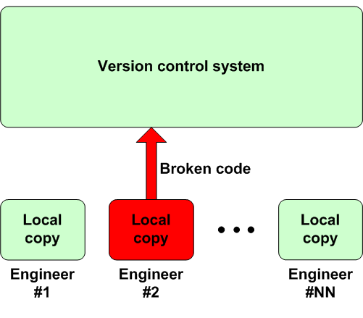
Contiuous integration

Slide 7
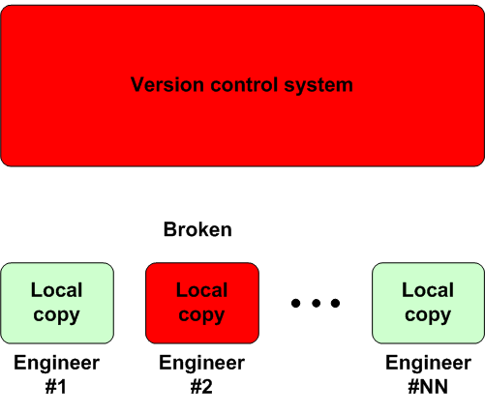
Contiuous integration

Slide 8
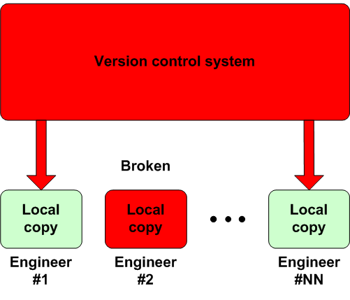
Contiuous integration

Slide 9
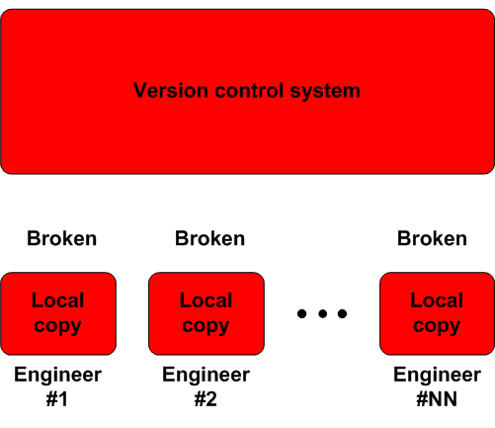
Contiuous integration

Slide 10
Continuos Deployment
Continuos Feedback
Continuos Inspection
Continuos testing
Continuos Integration

Slide 11
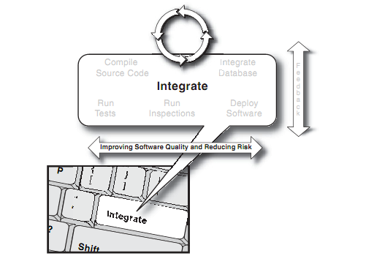
Contiuous integration
Integration
Don’t Commit Broken Code
Notes:
One of the central tenets of CI is integrating early and often. Develop-
ers must commit code frequently in order to realize the benefits of CI.
Waiting more than a day or so to commit code to the version control
repository makes integration time-consuming and may prevent devel-
opers from being able to use the latest changes. Try one or both of
these techniques to commit code more frequently.
• Make small changes—Try not to change many components all
at once. Instead, choose a small task, write the tests and source
code, run your tests, and then commit your code to the version
control repository.
• Commit after each task—Assuming tasks/work items have
been broken up so that they can be finished in a few hours, some
development shops require developers to commit their code as
they complete each task.
Try to avoid having everyone commit at the same time every day.
You’ll find that there are usually many more build errors to manage
because of the collisions between changes. This is especially trouble-
some at the end of the day, when people are ready to leave. The longer
you wait to integrate with others, the more difficult your integration
will prove to be.
----
Don´t commit broken code
A dangerous assumption on a project is that everyone knows not to
commit code that doesn’t work to the version control repository. The
ultimate mitigation for this risk is having a well-factored build script
that compiles and tests the code in a repeatable manner. Make it part of
the team’s accepted development practice to always run a private build
(which closely resembles the integration build process) before com-
mitting code to the version control repository.
-----
Fix Broken Builds Immediately
A broken build is anything that prevents the build from reporting suc-
cess. This may be a compilation error, a failed test or inspection, a
problem with the database, or a failed deployment. When operating in
a CI environment, these problems must be fixed immediately; fortu-
nately, in a CI environment, each error is discovered incrementally and
therefore is likely very small. Some projects have a penalty for break-
ing the build, such as throwing some money in a jar or placing the pic-
ture of the last developer to break the build on the company’s large-
screen monitor (just kidding; hopefully no one is doing this). The
project culture should convey that fixing a broken build is a top project
priority. That way, not just some but every team member can then get
back to what they were doing.
----
To prevent broken builds, developers should emulate an integration
build on their local workstation IDE after completing their unit tests.
This build allows you to integrate your new working software with the
working software from all the other developers,obtaining the changes
from the version control repository and successfully building locally
with the recent changes. Thus, the code each developer commits has
contributed to the greater good, with code that is less likely to fail on
the integration build server.

Slide 12
Contiuous integration
Integration
Commit de código de manera frecuente
No hacer commit de código con errores
Arreglar errores de forma inmediata
Correr builds privados (desde la IDE)

Slide 13
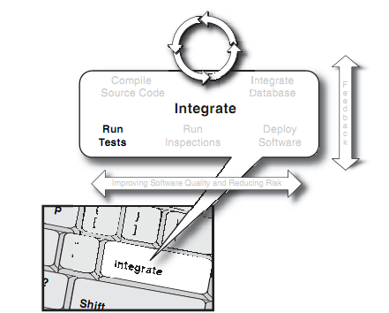
Contiuous integration
Testing

Slide 14
Contiuous integration
Testing
Automatizar Unit Tests
Automatizar System Tests
Automatizar Functional Tests
Notes:
Unit tests verify the behavior of small elements in a software sys-
tem, which are most often a single class. Occasionally, though, the
one-to-one relationship between a unit test and a class is slightly aug-
mented with additional classes because the classes under test are
tightly coupled.
Component or subsystem tests verify portions of a system and may
require a fully installed system or some external dependencies, such as
databases, file systems, or network endpoints, to name a few. These
tests verify that components interact to produce the expected aggregate
behavior. A typical component test requires the underlying database to
be running and may even cross architectural boundaries. Because
larger amounts of code are exercised by each test case, more code cov-
erage is obtained per test, and therefore, these tests tend to run longer
than unit tests.
Functional tests, as the name implies, test the functionality of a
application from the viewpoint of a client, which means the tests them
selves mimic clients. These tests are also known as acceptance tests

Slide 15
Contiuous integration
Testing
Categorizar los test de desarrollo
Correr los testt mas rápidos primero
Unit Tests
Component Tests
System TestsAutomate System Tests
Automatizar Functional Tests
Notes:
Writing and running tests is obviously a good thing, but unless we treat
them as an architectural component that requires proper categorization
and structure, they can start looking like a hurdle, instead of the key, to
success. As the code base increases during your project, we’re talking
about a lot of tests—and if you run all written tests at all times in your
CI system, builds take longer and longer to complete.
Categorizing developer tests into respective buckets (unit tests,
component tests, system tests, and even functional tests) helps you to
run slower running tests after the faster running tests. For example,
running system tests every time the repository changes is a time- and
resource-consuming task and delays notifying interested parties if
there happens to be an issue with the build. If this delay is too long and
developers have moved on to other activities, one of the primary bene-
fits of Continuous Integration is not realized. Why not run unit tests
every time someone checks code in, as they don’t take much time to
execute, and then schedule periodic intervals to run component tests
(or after commit builds) and then another interval scheme for system
tests? Those intervals can be increased as iterations come to a close,
and you probably want to run them more often in the initial project
stages too.
Typically, the majority of a build’s runtime is spent on tests, and the
longest tests are those with dependencies on outside objects such as
databases, file systems, and Web containers. Unit tests require the least
setup (by definition, none), and system tests need the most (every-
thing). By defining and grouping tests by type—unit, component, and
system—development teams can fashion a build process that runs test
categories rather than a gigantic test task that runs everything at once.
Unit tests run most often (with every commit); component tests, sys-
tem tests, and functional tests can be run with secondary builds or on
periodic intervals.

Slide 16
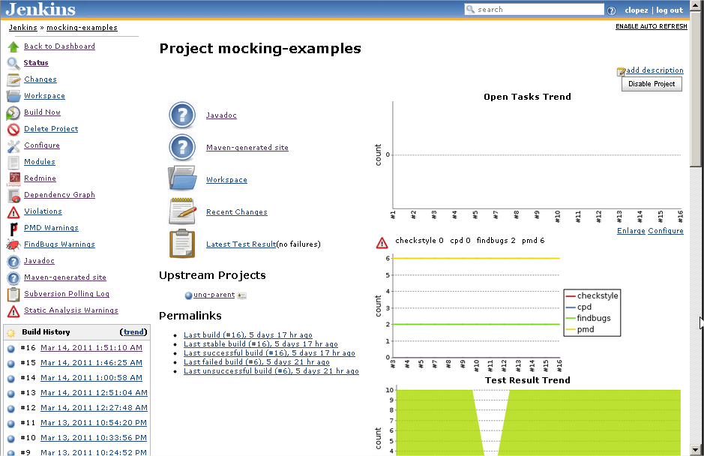
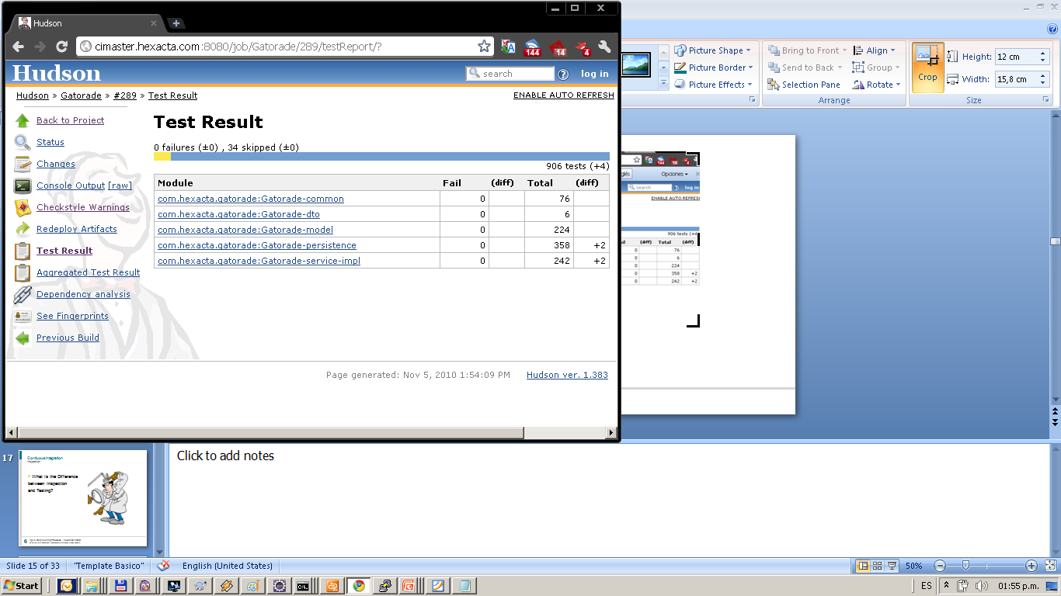
Contiuous integration
Testing – Test result
Notes:
Contiuous integration tool : Jenkins
Example : Test Rsult

Slide 17
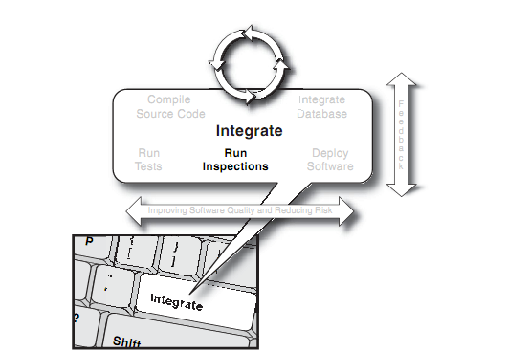
Contiuous integration
Inspection

Slide 18

Contiuous integration
Inspection
Diferencia entre
inspección
y testing?
Notes:
There are subtle differences between inspecting and testing software.
Testing is dynamic and executes the software in order to test the func-
tionality. Inspection analyzes the code based on a set of predefined
rules. Inspectors (or static and dynamic analysis tools) are directed by identi-
fied standards that teams should adhere to (usually coding or design
metrics). Examples of inspection targets include coding “grammar”
standards, architectural layering adherence, code duplication, and
many others that we discuss in this chapter. Testing and inspection are
similar concepts in the sense that both do not change the software
code; they only show where problems may reside. You do not achieve
higher quality software by inspecting and testing alone, of course; the
value isn’t manifested until you take action on the problems that are
reported by the tests and inspections.

Slide 19
Contiuous integration
Inspection
Detección de bugs por heuristicas
Detección de codigo repetido
Violaciones de estandars de codificación
Warnings de compilacion
Reportes de marcas TODO, FIXME, BUG
Etc etc
Notes:
A number of studies over time have shown a correlation between
the number of paths through code and defects. One metric that arose
from these studies is called the Cyclomatic Complexity Number
(CCN). The CCN is a plain integer that measures complexity by count-
ing the number of distinct paths through a method. Various studies
with this metric over the years have determined that methods with a
CCN greater than 10 have a higher risk of defects than other code of
the same bulk.
---
There are other useful metrics that blossomed in the latter part of the
twentieth century. Have you ever noticed that objects that have a lot of
dependencies on other objects become somewhat brittle? If one of
their dependencies changes, the object itself may break. From the
other direction, when you change an object that every other object in a
system depends on, it creates issues elsewhere. (This tendency is com-
monly referred to as the “collateral damage” effect.) It is important to
be poised for unanticipated change (the one constant), and you don’t
want dependencies holding you back from creating changes that you
wish to make.
Two metrics most helpful in determining over-coupling are known
as Afferent Coupling and Efferent Coupling (sometimes called Fan
In and Fan Out, respectively). These simple integer metrics count the
relationships to or from objects. Both Afferent and Efferent Coupling
signify an architectural maintenance issue: Either an object has
responsibility to too many other objects (highly afferent) or the object
isn’t sufficiently independent of other objects (highly efferent).
In a CI environment, a code analysis tool can be run any time a
change is made to the project’s repository. The tool can analyze an
individual file when it is changed, or analyze the entire code base
when structural or other system changes are made. What’s more, due
to the nature of CI, interested parties can be instantly notified of viola-
tions in architecture or coding. For instance, a popular code analysis
tool for the Java platform PMD has more than 180 customizable rules
in categories ranging from braces placement in conditionals to naming
conventions, design conventions (like simplifying conditionals, etc.),
and even unused code.

Slide 20
Contiuous integration
Integration
Code Metrics
Reduce Duplicate Code
Evaluate Code Quality Continuously

Slide 21
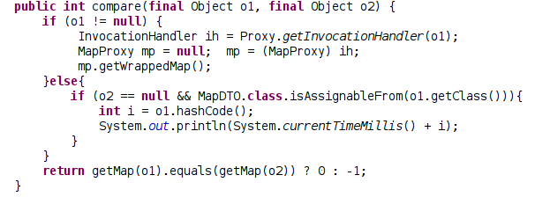
Contiuous integration
Inspection – PMD (detection example)
Notes:
o1.getCLass() is a bug (NullPointerException).
This error is detected at PMD tool or FindBug.

Slide 22
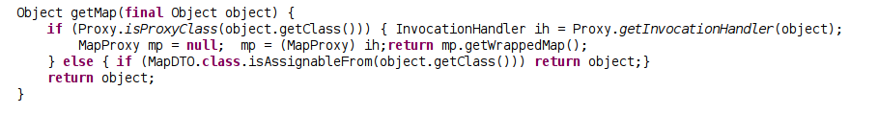

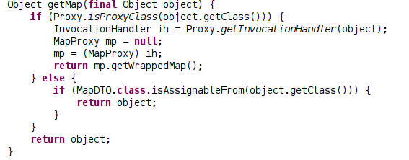

Contiuous integration
Inspection
Bad
Good
Notes:
The first example show code without format and second example show more understandable

Slide 23
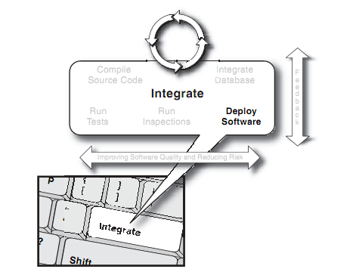
Contiuous integration
Deployment
Notes:
Automated builds and repeatable builds. Automated tests and repeatable tests. Test categories and test frequencies. Continuous inspections.
Continuous database integration. This string of tasks in creating an effective CI environment primarily enables one key benefit: releasing
working software at any point in time, in any environment. As we said, if you can’t release your software, then it’s almost as if it doesn’t exist.
What makes up a typical deployment? Regardless of platform, technology, or domain, deploying working software principally
embodies six high-level steps.
Label a repository’s assets.
Produce a clean environment, free of assumptions.
Generate and label a build directly from the repository and install it on the target machine.
Successfully run tests at all levels in a clone of the production environment.
Create build feedback reports.
If necessary, you can roll back the release by using labels in your version control repository.
Once your CI environment is established, these sometimes painful steps can become as easy as pushing the Integrate button. You still need
to keep track of which of the delivered features were supposed to be delivered based on customer expectations (bill of materials), but you
know that what is in there all works and constitutes working software.
The single command should be as simple as typing ant deploy.

Slide 24
Contiuous integration
Integration
Etiquetar cada build
Correr TODOS los test
Crear reportes de feedback
Tarea muy compleja pero representa una gran ventaja

Slide 25
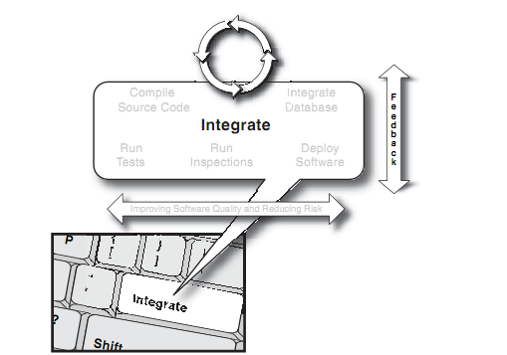
Contiuous integration
Feedback

Slide 26
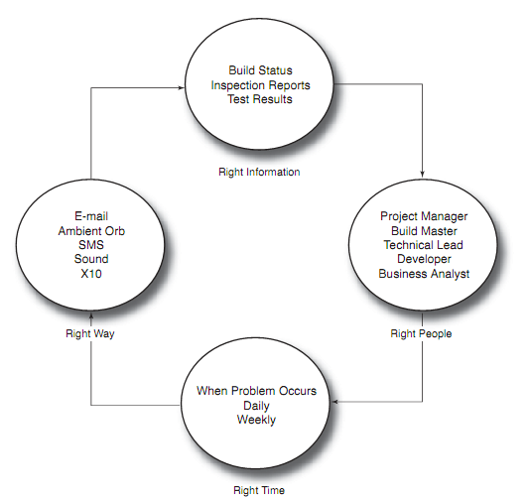
Contiuous integration
Feedback

Slide 27
Contiuous integration
Feedback
Todo el tiempo de todas las formas
Notificaciones
E-mail
SMS
RSS
Notes:
Continuous feedback doesn’t take the action to improve the software, project members do—typically, software developers. The information
may be useful to others, such as analysts, testers, and management, aswell. Continuous feedback provides the means to structure the infor-
mation, and you decide what portions are delivered to which project members upon certain events. You and the other recipients know both
that the information is accurate and fresh and that you are taking the most effective action to solve an issue. Instead of waiting for stake-
holders to notice they have questions and then putting them to you, you can devise notifications for them on a particular concern and have th
notices sent regularly and/or right when an issue develops.

Slide 28
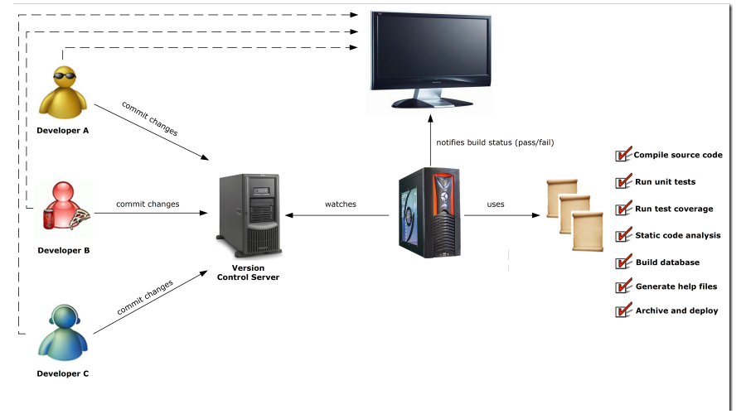


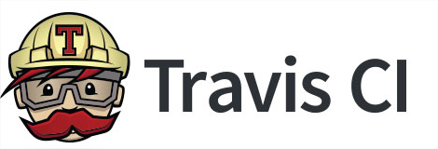
Contiuous integration

Slide 29


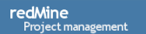







Ambiente ágil
Checkstyle

